Slide 1
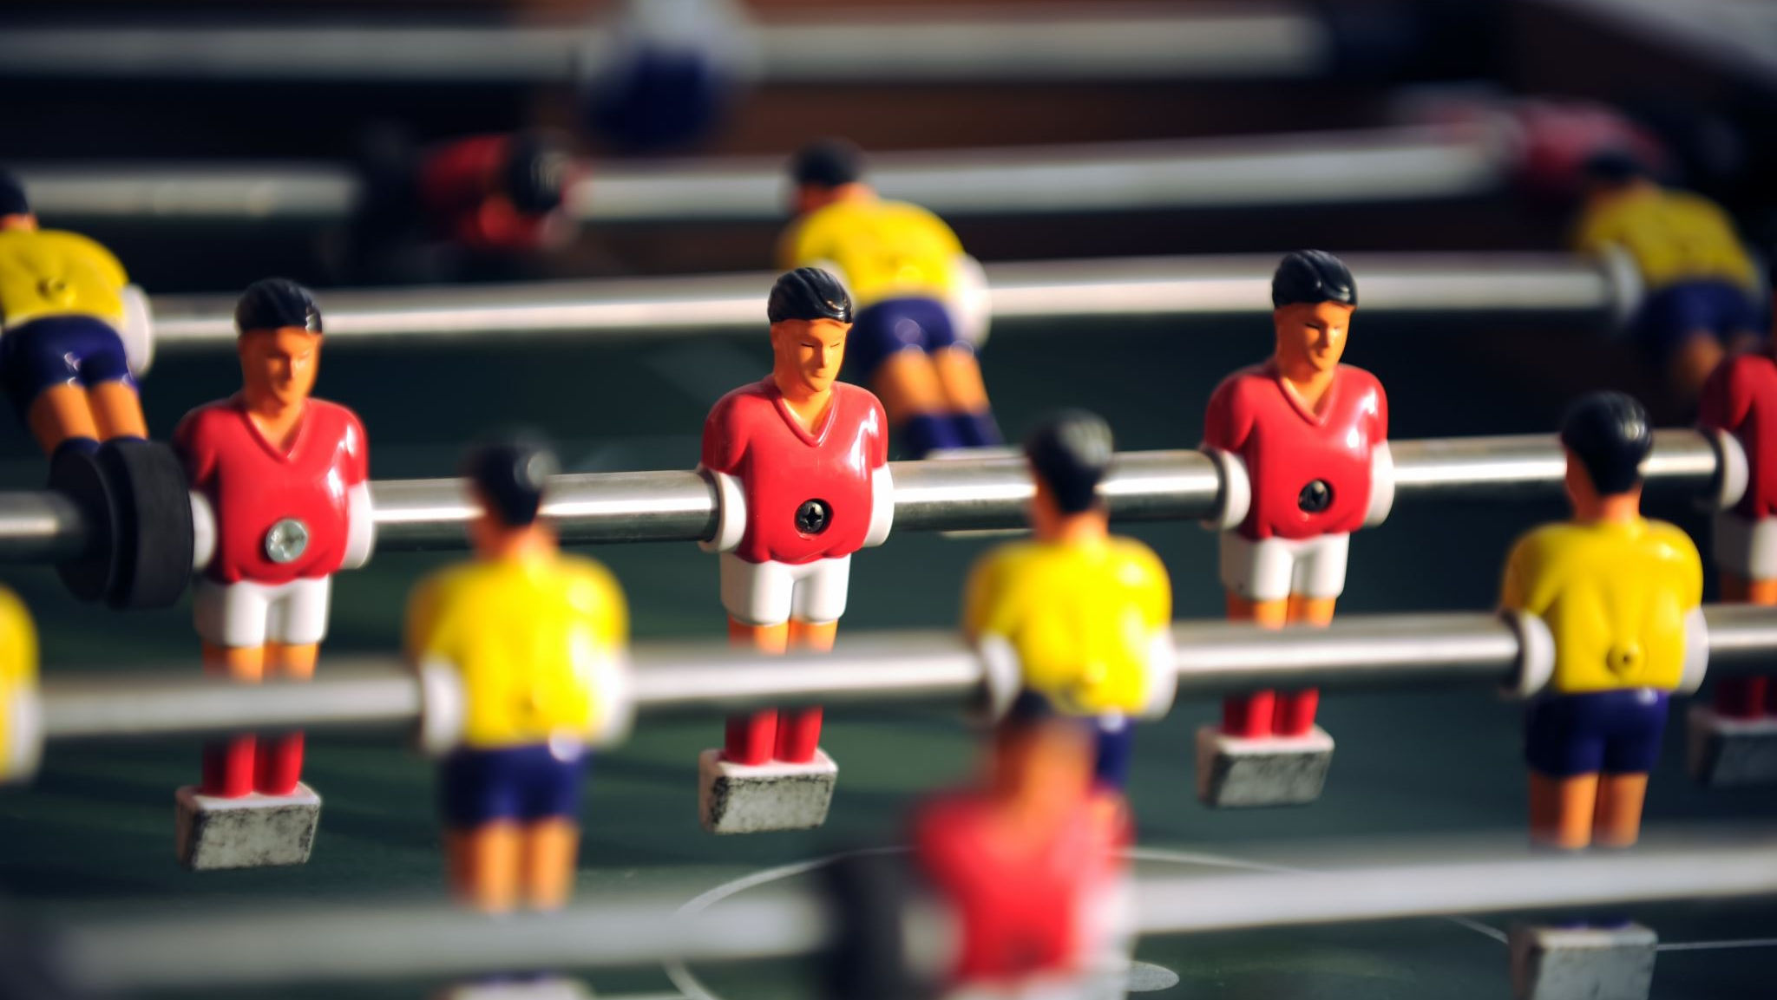
Single Player Magnetic Soccer

Slide 2
Basis
Built on the Magnets demo.
Imported a 3d model of a soccer goal.
Reversed magnetism of the spheres and removed all but two.
Increased radius of the sphere’s force influence, in order to give it a bouncy feel.
When the red sphere is within the local positions of the goal posts, a goal is counted, and the red sphere is reset.
Respawns are alternated based on the direction the ball came from.

Slide 3
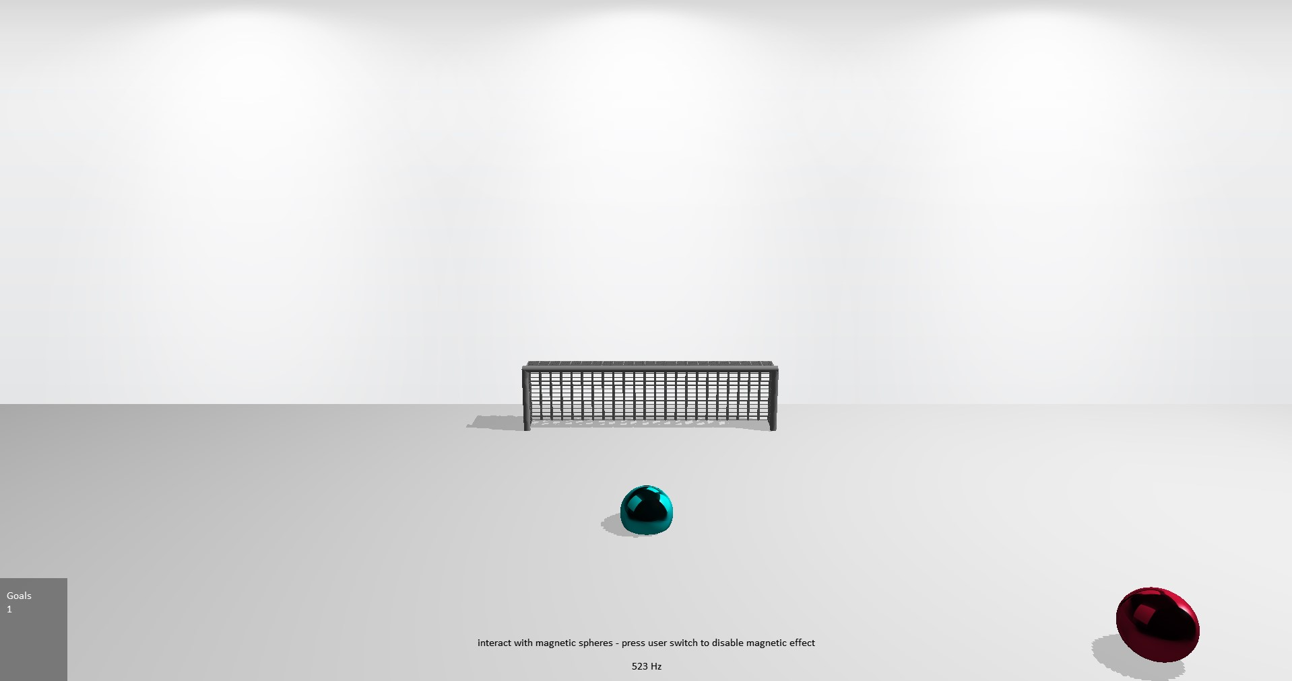
The height and the size of the goal was reduced to make bouncing the spheres less viable.

Slide 4
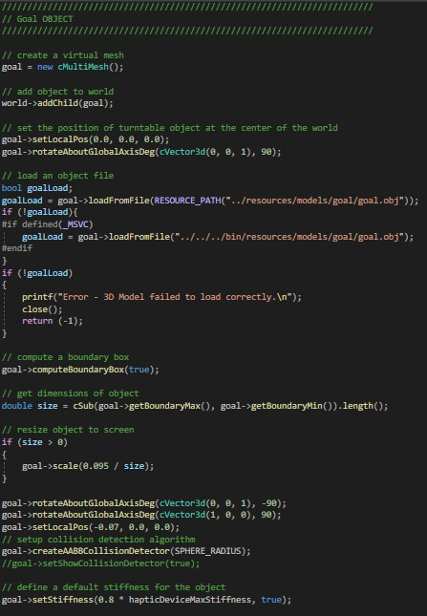
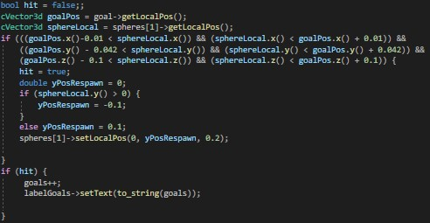
Code Snippets
Below: “Hit” Detection, compares local positioning of the goal and the sphere to determine whether a point has been made, then respawns the ball at a different location to prevent multiple points being scored at once.
Above: Creating goal as a multimesh object with collision detection.

Slide 5
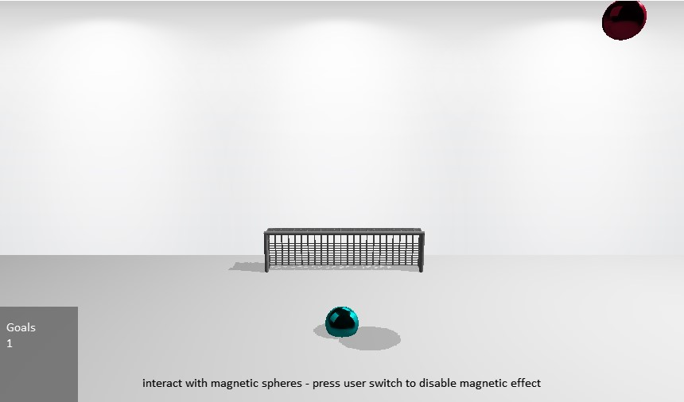
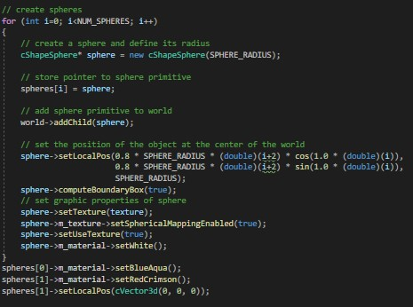
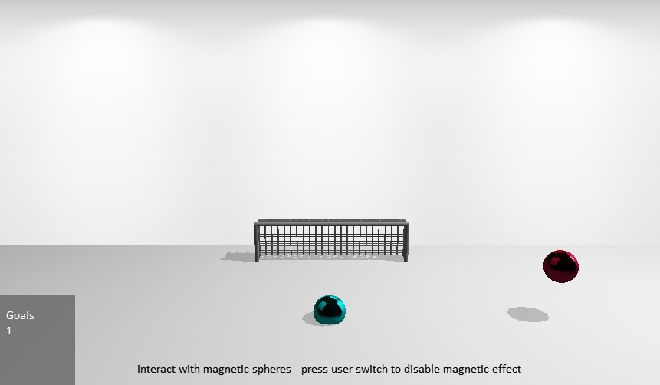
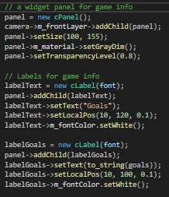
Above: Mild edits to sphere creation were made
Left: A new panel was needed to display extra game info

